Slide 1

WELCOME TO
SPOTIFY DATA DASHBOARD OVERVIEW

Slide 2





INTRODUCTION
This report explores Spotify data, examining trends in song streams, top artists, and regional distribution. The analysis highlights the popularity of songs across various regions and over time.

Slide 3

NUMBER OF SONGS BY REGION
The dataset reveals a significant concentration of songs in specific regions. Popular music hubs have a higher volume of songs, indicating regional dominance in the music industry.

Slide 4

SONG STREAMS BY REGION
Streams are heavily skewed toward a few key regions. These areas contribute the most to the total streams, reflecting the music preferences and consumption habits of their audiences.

Slide 5
POPULARITY TRENDS OVER TIME
The average popularity of songs fluctuates over time, with distinct peaks during certain periods. This suggests trends driven by seasonal hits, events, or viral moments in the music world.

Slide 6

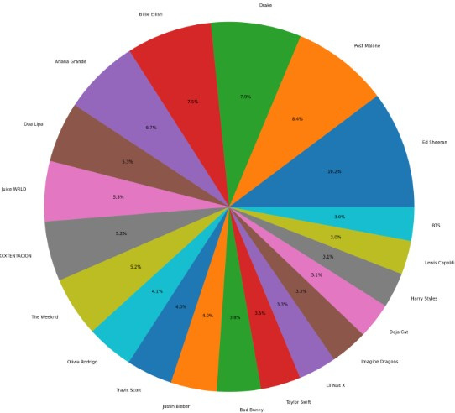
TOP ARTISTS
Leading artists like Billie Eilish and others consistently rank among the most streamed globally. Their music resonates across multiple regions, showing strong fan bases.

Slide 7
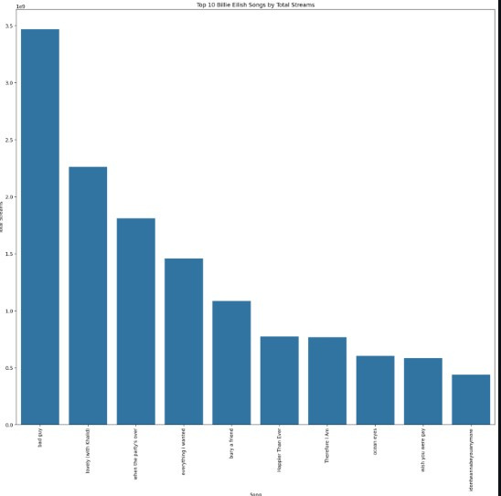
Billie Eilish's Top Songs
Billie Eilish's top songs have amassed millions of streams. Her distinct sound and broad appeal have made her one of the most successful artists on the platform.

Slide 8

CONCLUSION
The analysis provides valuable insights into Spotify's global music trends. Regional preferences, top-performing songs, and leading artists highlight the evolving landscape of the music industry. The data underscores how a few key regions and popular artists, like Billie Eilish, dominate streaming platforms. Understanding these patterns can help predict future music trends and inform strategic decisions for artists, labels, and marketers.

